Slide 1
Research ethics

Slide 2
Context in the U.S. (see Bit by Bit)
Ethical failures
Tuskegee Syphilis Study
Stanford prison experiment
Milgram experiment
Wakeup call
Need for improved governance of research ethics
New guidelines for human-subject research
Notes:
Discussion on US context: there were important ethical issues which lead to development of a stronger institutionalized approach to research ethics

Slide 3
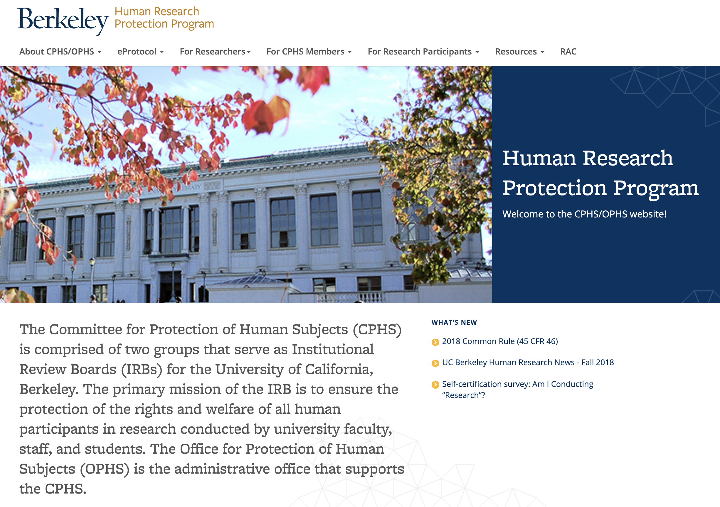
Context in the U.S. – the IRB

Slide 4
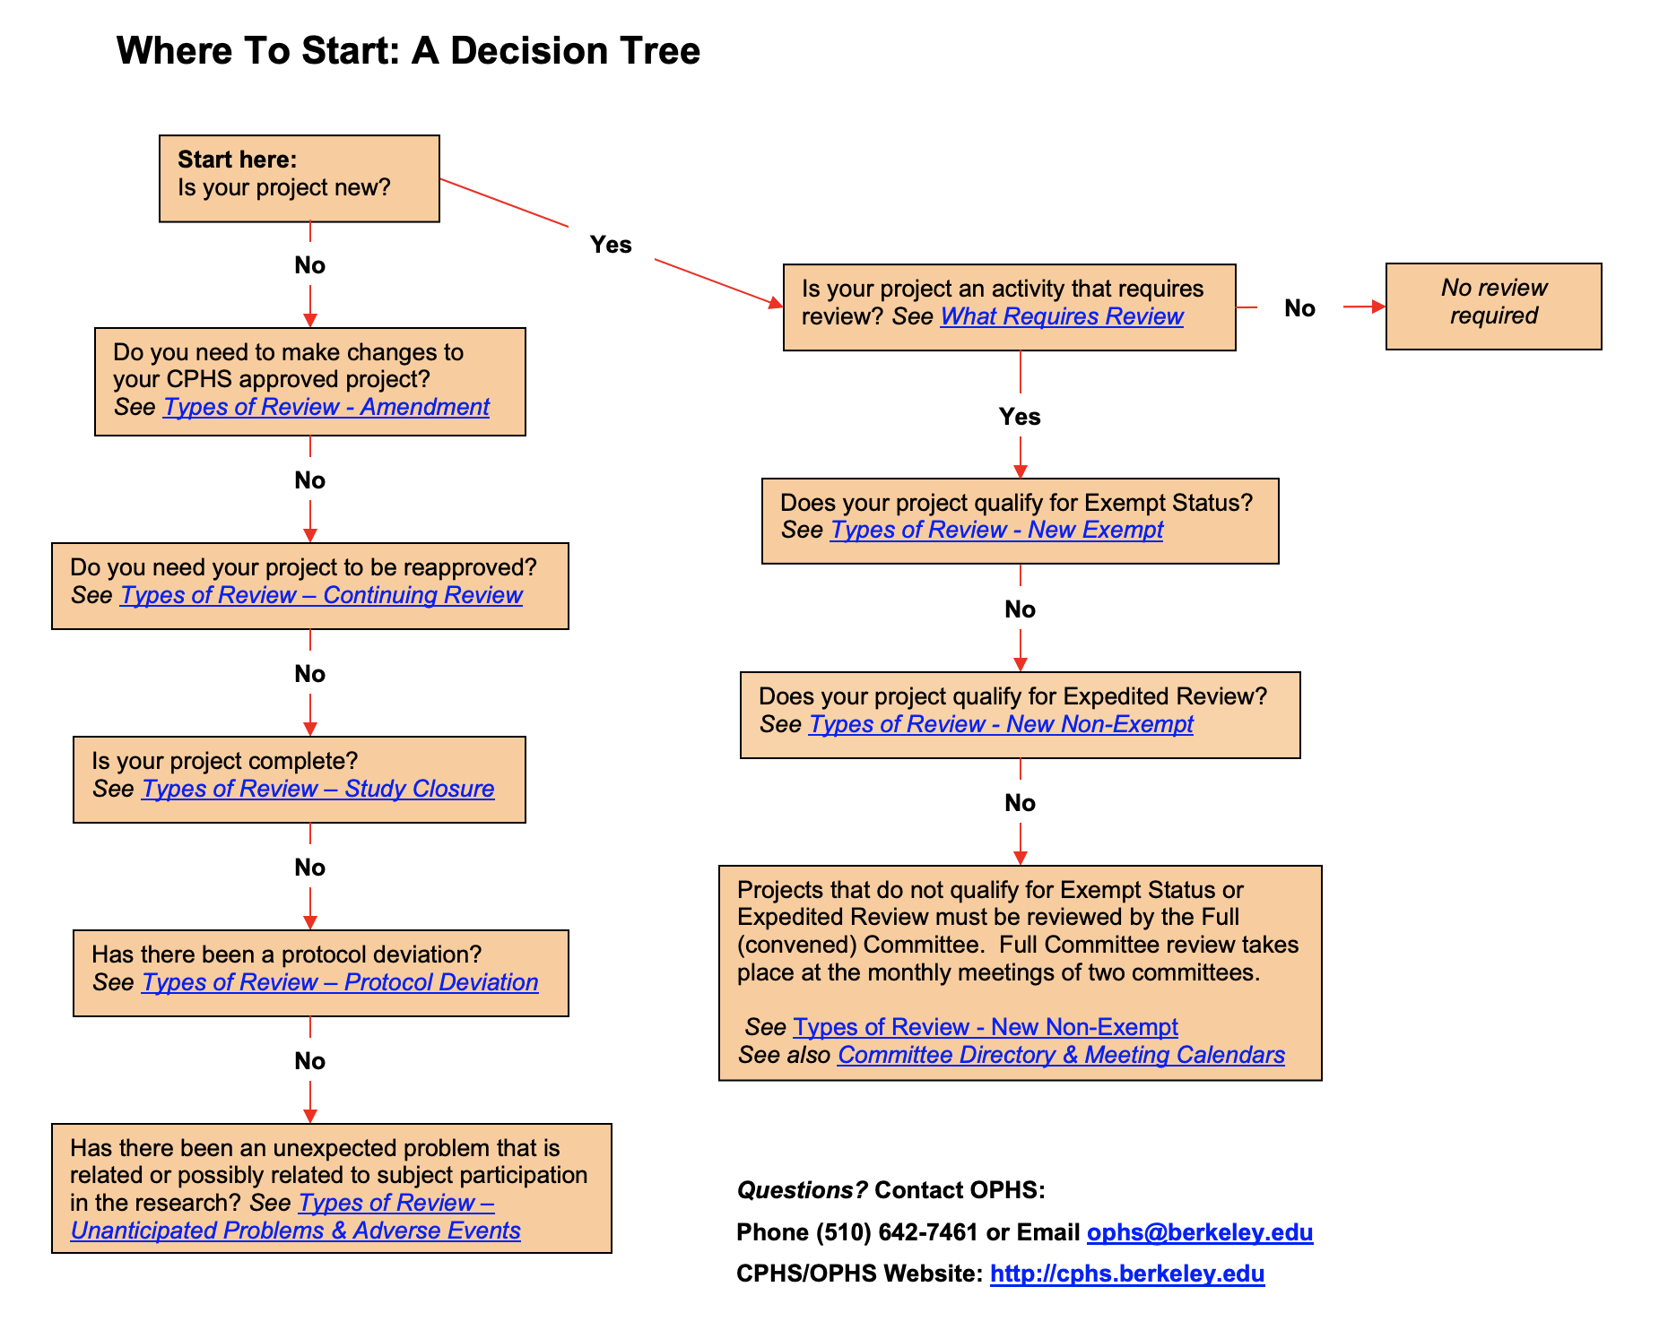
Context in the U.S. – the IRB

Slide 5
Context in Finland
Research ethics mostly considered by the researcher

Slide 6
Context in Finland
Research ethics mostly considered by the researcher
Ethical review required only in special cases
Notes:
So this is just an example about Finnsh contect, trying to highlight the differences between US practice and other practices

Slide 7
Context in Finland
1. The study involves an intervention in the physical integrity of subjects,
2. The study deviates from the principle of informed consent (ethical review is not required if the research is based on public documents, registries or archived data),
3. The subjects are children under the age of 15, and the study is not part of the normal activities of a school or an institution of early childhood education and care, and the data are collected without parental consent and without providing the parents or guardians the opportunity to prevent the child from taking part in the study,
4. The study exposes research subjects to exceptionally strong stimuli and evaluating possible harm requires special expertise (for example, studies containing violence or pornography),
5. The study may cause long-term mental harm (trauma, depression, sleeplessness) beyond the risks encountered in normal life,
6. The study can signify a security risk to subjects (for example, studies concerning domestic violence).
Research ethics mostly considered by the researcher
Ethical review required only in special cases

Slide 8
Context in Finland
1. The study involves an intervention in the physical integrity of subjects,
2. The study deviates from the principle of informed consent (ethical review is not required if the research is based on public documents, registries or archived data),
3. The subjects are children under the age of 15, and the study is not part of the normal activities of a school or an institution of early childhood education and care, and the data are collected without parental consent and without providing the parents or guardians the opportunity to prevent the child from taking part in the study,
4. The study exposes research subjects to exceptionally strong stimuli and evaluating possible harm requires special expertise (for example, studies containing violence or pornography),
5. The study may cause long-term mental harm (trauma, depression, sleeplessness) beyond the risks encountered in normal life,
6. The study can signify a security risk to subjects (for example, studies concerning domestic violence).
Research ethics mostly considered by the researcher
Ethical review required only in special cases
➔ Most social science research does require formal approval, but is based on my own considerations.

Slide 9
Context in Finland
1. The study involves an intervention in the physical integrity of subjects,
2. The study deviates from the principle of informed consent (ethical review is not required if the research is based on public documents, registries or archived data),
3. The subjects are children under the age of 15, and the study is not part of the normal activities of a school or an institution of early childhood education and care, and the data are collected without parental consent and without providing the parents or guardians the opportunity to prevent the child from taking part in the study,
4. The study exposes research subjects to exceptionally strong stimuli and evaluating possible harm requires special expertise (for example, studies containing violence or pornography),
5. The study may cause long-term mental harm (trauma, depression, sleeplessness) beyond the risks encountered in normal life,
6. The study can signify a security risk to subjects (for example, studies concerning domestic violence).
Research ethics mostly considered by the researcher
Ethical review required only in special cases
➔ Most social science research does require formal approval, but is based on my own considerations.
But: there is a process to get an IRB evaluation to your research in case that the publication outlet requires such evaluation.

Slide 10
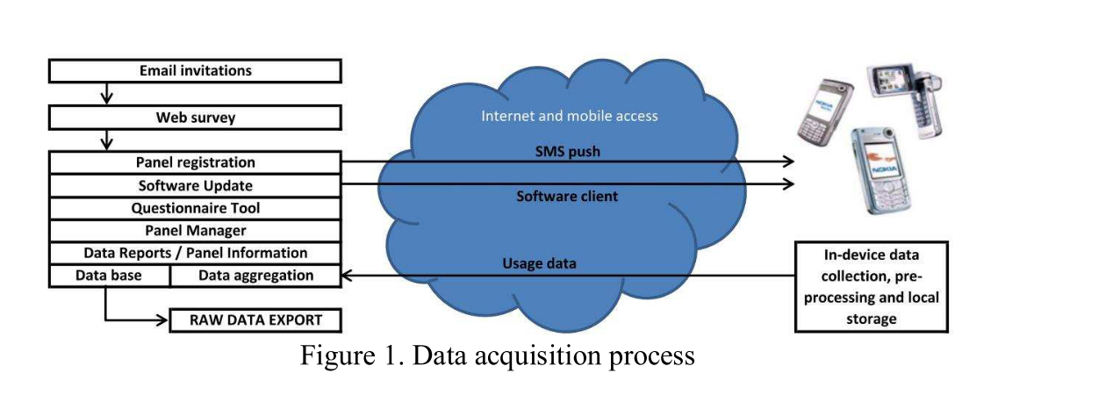
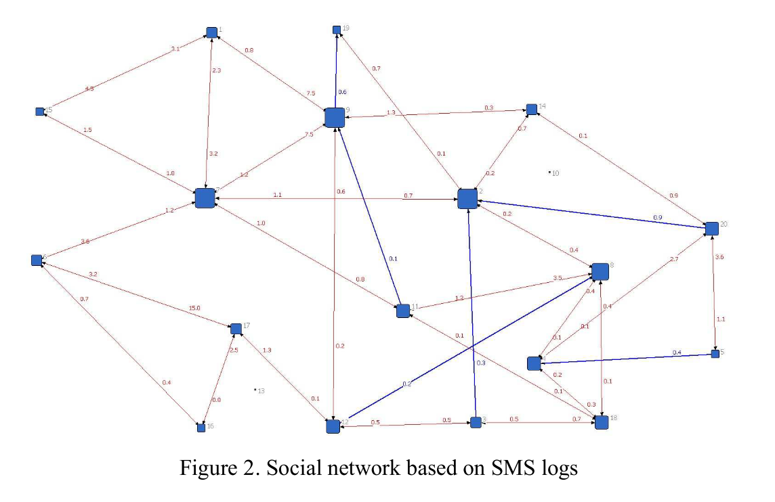
Context do clash!
Karikoski, J., & Nelimarkka, M. (2010). Measuring Social Relations: Case OtaSizzle. In 2010 IEEE Second International Conference on Social Computing (pp. 257–263). Ieee. https://doi.org/10.1109/SocialCom.2010.43
Notes:
Study I was involved: collecting social networks using in-device logging, that is, spying with a permission what people do in their mobile device. In Finland, totally OK and except from ethical review as we were studying young adults; consenting was OK. (Also, data analysed only across people consenting). Presenting this research in an US conference raised questions about our research ethics, as we did not have IRB approval for our research (Finland did not even have IRB at that time).

Slide 11
What about your country?

Slide 12
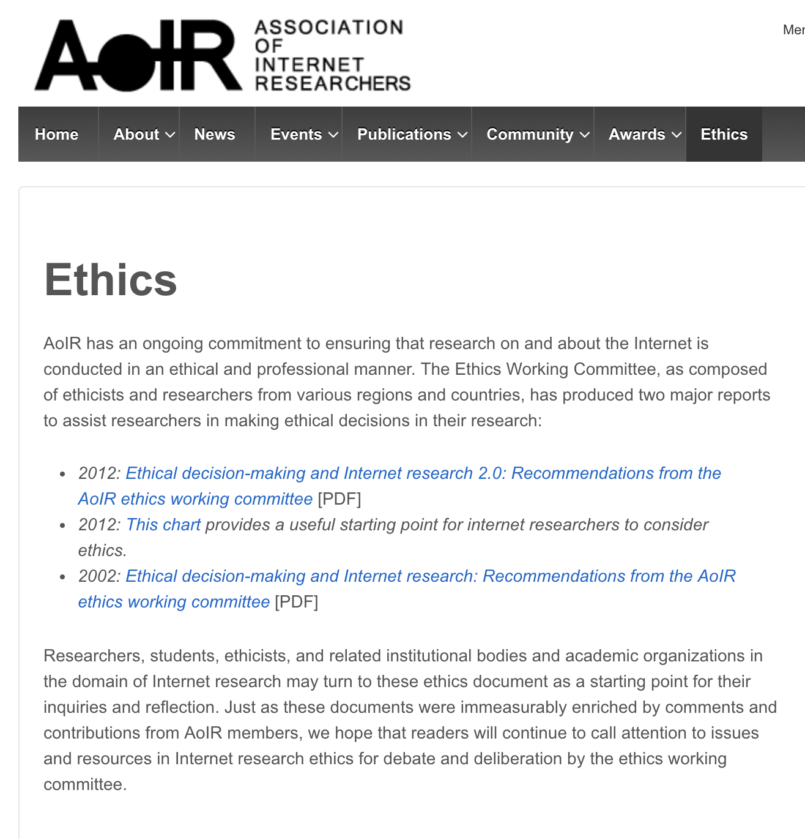
Scientific communities and research ethics
Notes:
So, as different countires have widely different research ethics practices, one direction is to look beyond national or university contexts to research communities. For example, Association of Internet researchers has worked on research ethics for long time.

Slide 13
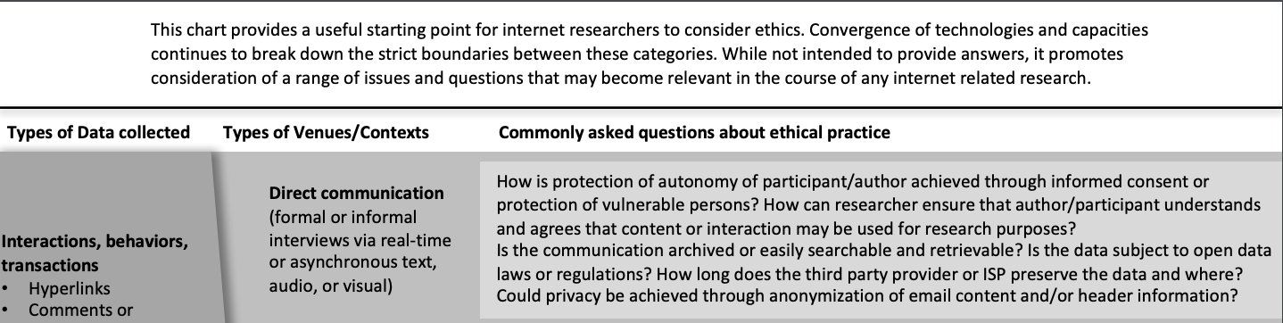
Scientific communities and research ethics
Notes:
Scientific communities support in research ethics, but they rarely provide clear yes/no answers, rather support through questions

Slide 14

Scientific communities and research ethics

Slide 15

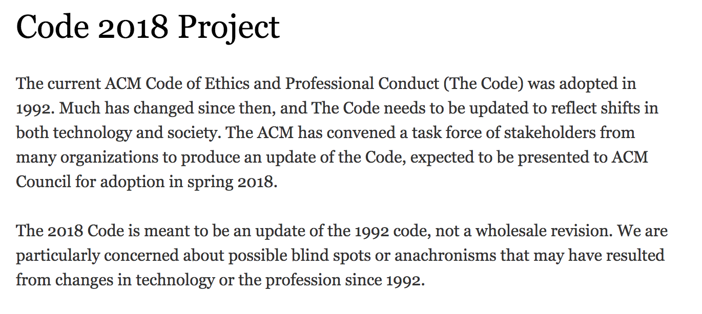
Scientific communities and research ethics

Slide 16
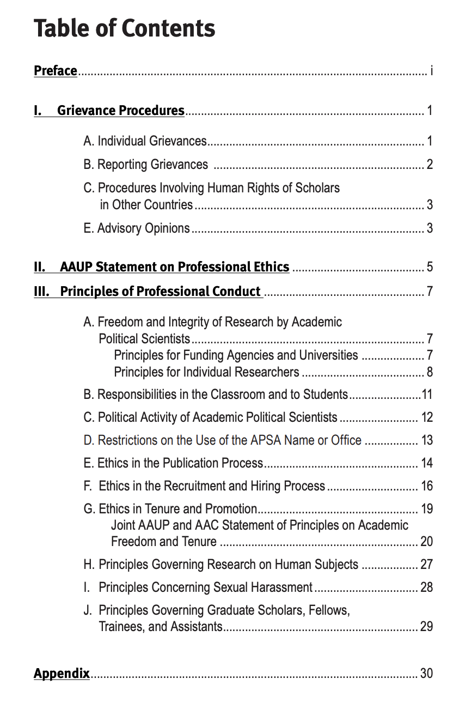
Scientific communities and research ethics
Notes:
Also, ethics goes beyond research ethics – for exampole, publication process, relationships and even social impact is ethical issue. In human-computer interaction research, we have begun to ask if there are societal implications of the proposed novel technologies which should be addressed and raised this as an ethical frontier. Also the recent debate on AI ethics has a similar problem domain: what impacts our work may have with the wider society?

Slide 17
Research design: what we should do, not anymore what we could do?
Notes:
So, in many cases research ethics has again surfaced as a topic as we can do much more than previously in terms of research and the scale and impact of the research could be much much higher than before.

Slide 18

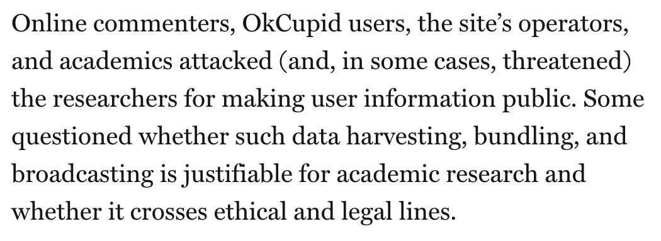
Notes:
Sio this is why these things are relevant again: we can do a lot of stuff, but it is unclear if we want to do that stuff.

Slide 19
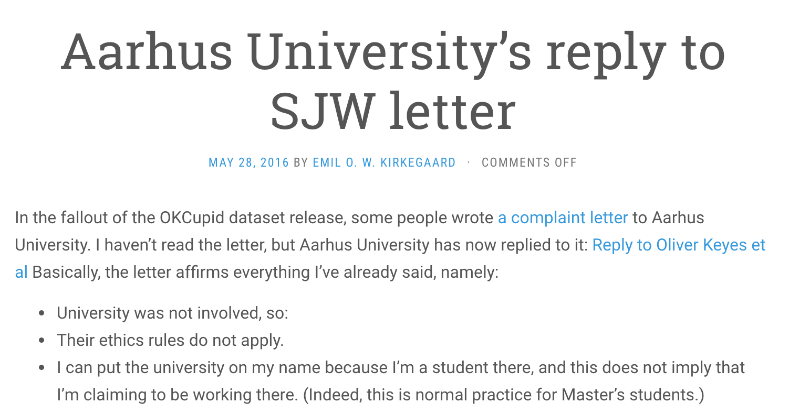

Slide 20
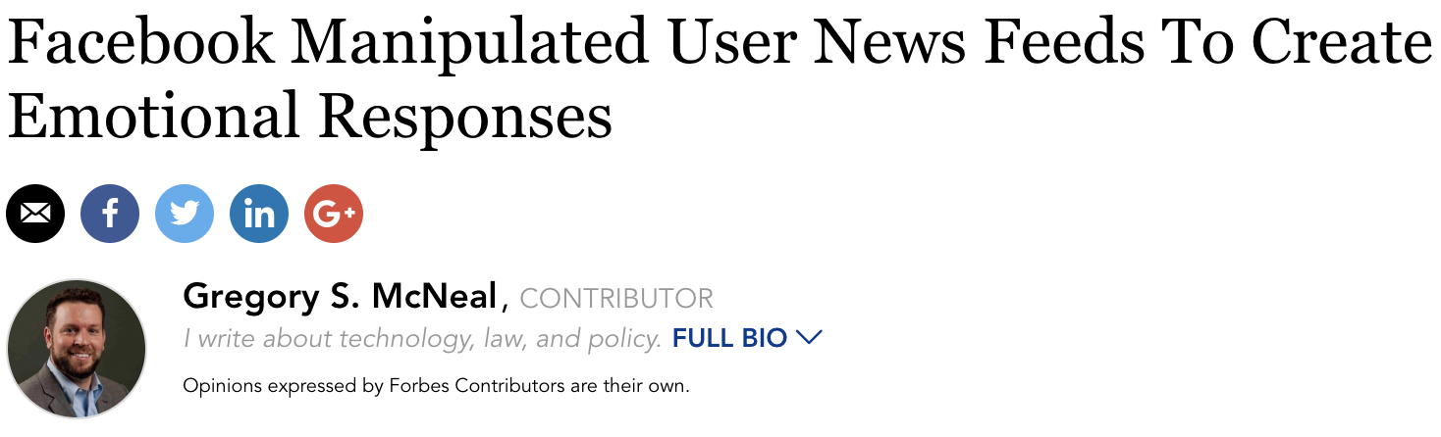

Slide 21
Bit by bit:
Rules based approach
Ad hoc approach
Principles-based approach

Slide 22
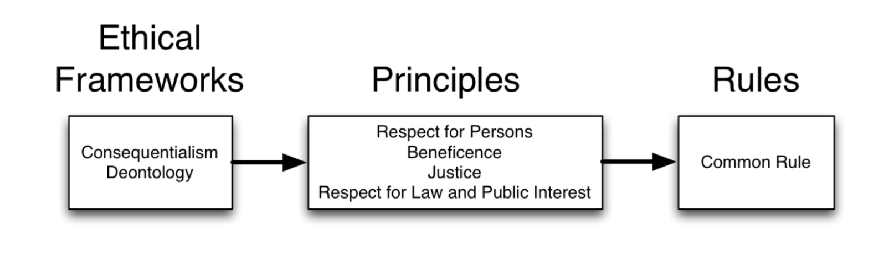
Notes:
From bit-by-bit, there are different frameworks which lead to principles which then lead to different rules of ethical interprentation.

Slide 23
No explicit rules in Finland
Notes:
So, in Finland as there are no explicit rules, we work more on frameworks and principles

Slide 24
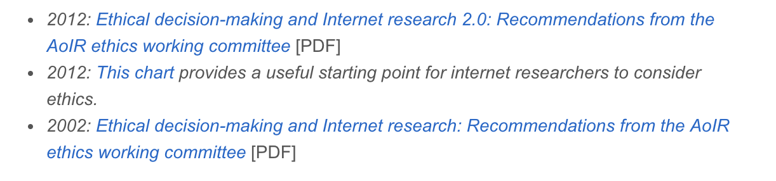
Development of “rule based”

Slide 25
The law and research ethics

Slide 26

Data and GDPR

Slide 27
https://www.youtube.com/watch?v=j6wwBqfSk-o

Slide 28
information about the processing of your personal data;
obtain access to the personal data held about you;
ask for incorrect, inaccurate or incomplete personal data to be corrected;
request that personal data be erased when it’s no longer needed or if processing it is unlawful;
object to the processing of your personal data for marketing purposes or on grounds relating to your particular situation;
request the restriction of the processing of your personal data in specific cases;
receive your personal data in a machine-readable format and send it to another controller (‘data portability’);
request that decisions based on automated processing concerning you or significantly affecting you and based on your personal data are made by natural persons, not only by computers. You also have the right in this case to express your point of view and to contest the decision.

Slide 29


Slide 30
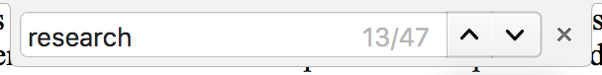

Slide 31
information about the processing of your personal data;
obtain access to the personal data held about you;
ask for incorrect, inaccurate or incomplete personal data to be corrected;
request that personal data be erased when it’s no longer needed or if processing it is unlawful;
object to the processing of your personal data for marketing purposes or on grounds relating to your particular situation;
request the restriction of the processing of your personal data in specific cases;
receive your personal data in a machine-readable format and send it to another controller (‘data portability’);
request that decisions based on automated processing concerning you or significantly affecting you and based on your personal data are made by natural persons, not only by computers. You also have the right in this case to express your point of view and to contest the decision.
Notes:
Note that in research different execptions exists and you may not need to follow all things defined and setup by GDPR

Slide 32
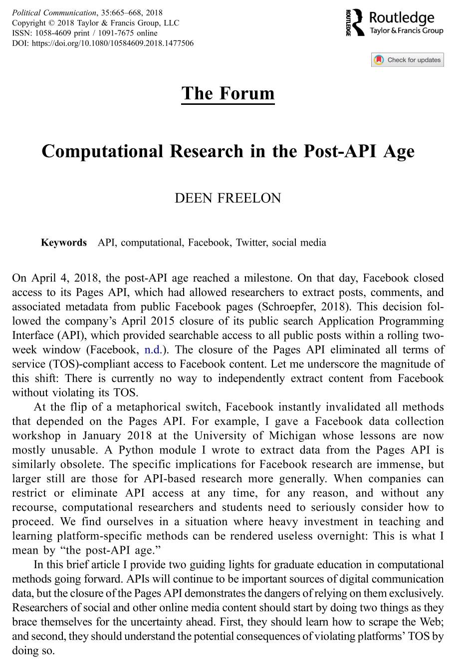
Terms of Service (TOS) and research ethics

Slide 33
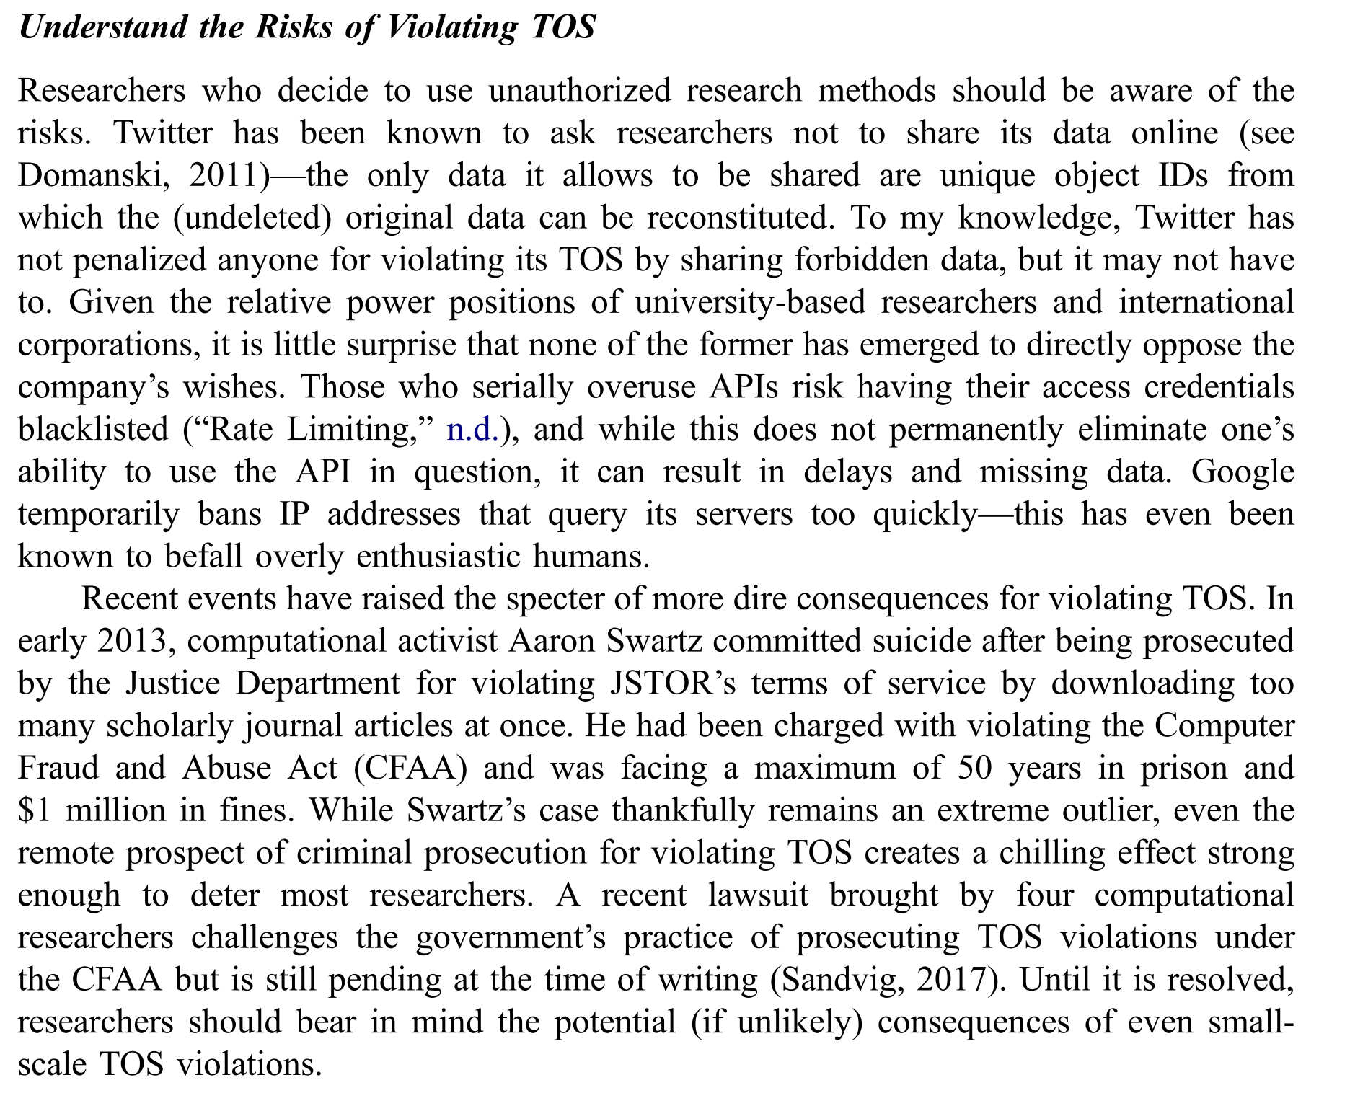
Terms of Service (TOS) and research ethics

Slide 34
Terms of Service (TOS) and research ethics
Very US centric discussion. EULA and TOS in Europe have different degree of enforcability and national laws differ as well (also, in US different states may have different positions.)

Slide 35

Notes:
So the final outcome is a headache. You can ask support from your universities lecal support to figure it out. Or you can fall back to research the principle approach for research ethics

Slide 36
Notes:
From bit-by-bit, there are different frameworks which lead to principles which then lead to different rules of ethical interprentation.

Slide 37
Notes:
So, in Finland as there are no explicit rules, we work more on frameworks and principles

